Slide 1
Trees

Slide 2
Outline
Tree Data Structure
Tree Traversal
Binary Search Tree
AVL Tree
Spanning Tree
Heap

Slide 3

Introduction
Other data structures such as arrays, linked list, stack, and queue are linear data structures that store data sequentially.
In order to perform any operation in a linear data structure, the time complexity increases with the increase in the data size. But, it is not acceptable in today's computational world.
Different tree data structures allow quicker and easier access to the data as it is a non-linear data structure.
One reason to use trees might be because you want to store information that naturally forms a hierarchy. For example, the file system on a computer.

Slide 4
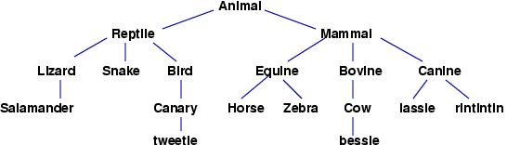

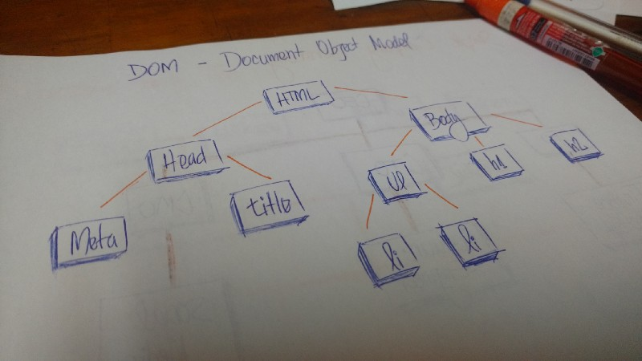
Examples

Slide 5
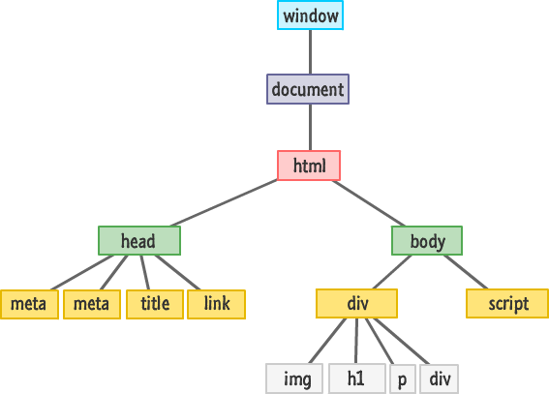
Applications
The tree data structure must be help us in some aspect of this data process.
One of the most intuitive examples of a tree data structure in the world of programming is the Document Object Model (DOM) in HTML.
It becomes simpler to “traverse” through the tree in order for the programmer to access related nodes. For example, it enables access to all siblings of a currently selected node. The tree structure becomes a road map that can be followed to traverse throughout the HTML document.

Slide 6
2. Search
As each of the nodes is connected in a hierarchical manner, it is therefore possible to structure the tree so that it allows for specific data to be found more efficiently.

Slide 7
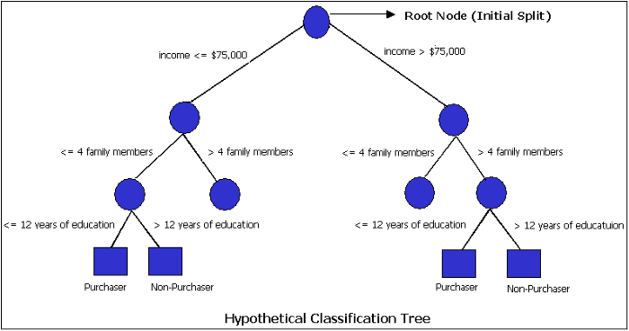
3. Decision Making
Use a binary tree as an algorithm to aid in decision making

Slide 8
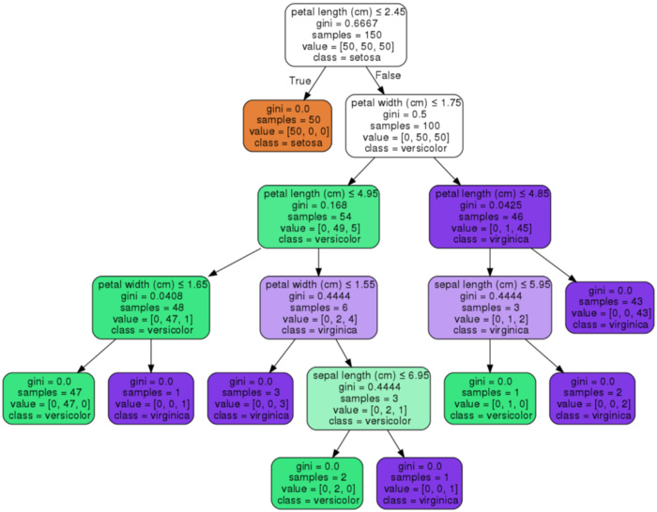
4. Machine Learning Algorithms
Have a computer utilize machine learning principles to determine how the binary tree should be set up so that it consistently provides the correct answer to a question

Slide 9
Tree Terminologies

Slide 10
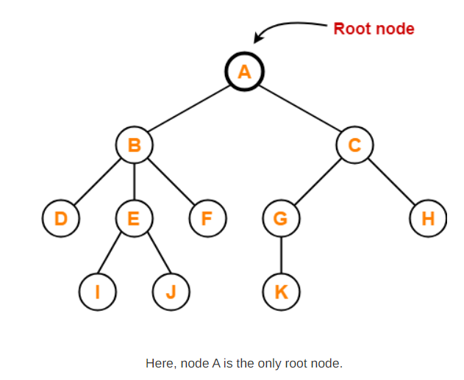
Root
The first node from where the tree originates is called as a root node.
In any tree, there must be only one root node.
We can never have multiple root nodes in a tree data structure.

Slide 11
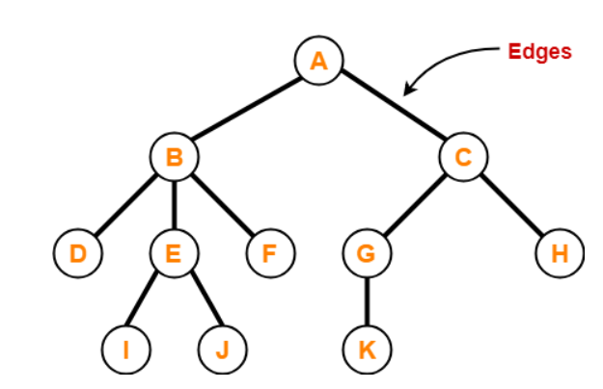
Edge
The connecting link between any two nodes is called as an edge.
In a tree with n number of nodes, there are exactly (n-1) number of edges.

Slide 12
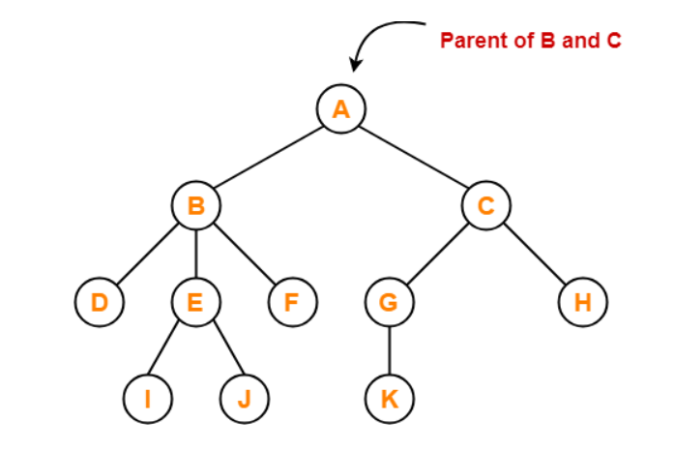
Parent
The node which has a branch from it to any other node is called as a parent node.
In other words, the node which has one or more children is called as a parent node.
In a tree, a parent node can have any number of child nodes.

Slide 13
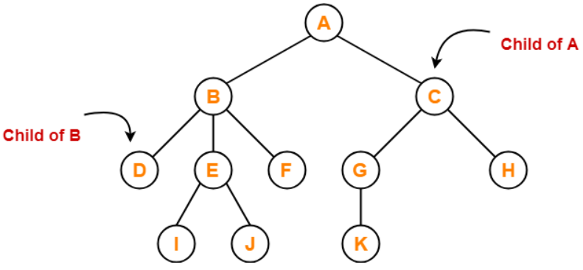
Child
The node which is a descendant of some node is called as a child node.
All the nodes except root node are child nodes.

Slide 14
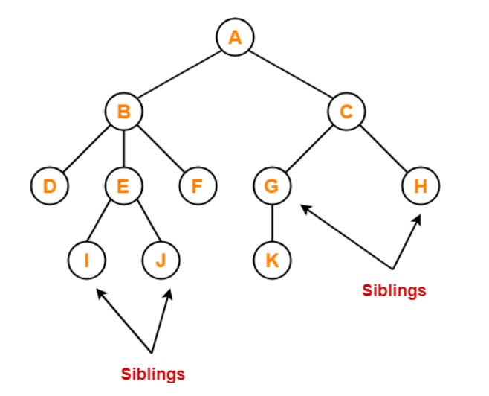
Siblings
Nodes which belong to the same parent are called as siblings.
In other words, nodes with the same parent are sibling nodes.

Slide 15
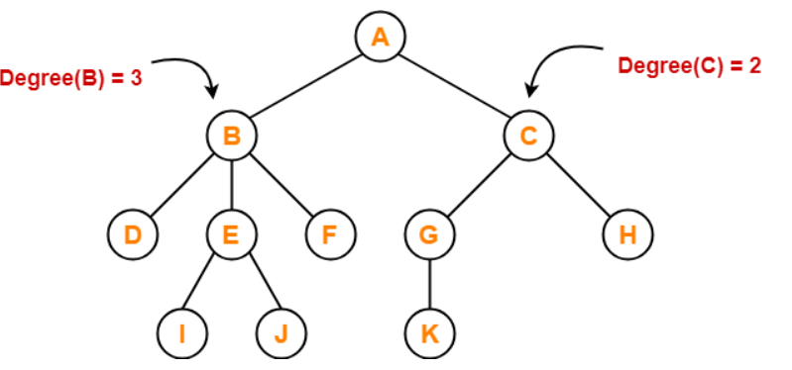
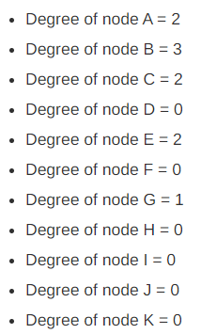
Degree
Degree of a node is the total number of children of that node.
Degree of a tree is the highest degree of a node among all the nodes in the tree.

Slide 16
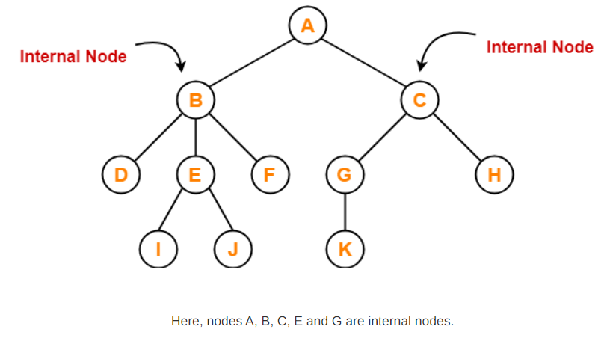
Internal Node
The node which has at least one child is called as an internal node.
Internal nodes are also called as non-terminal nodes.
Every non-leaf node is an internal node.

Slide 17
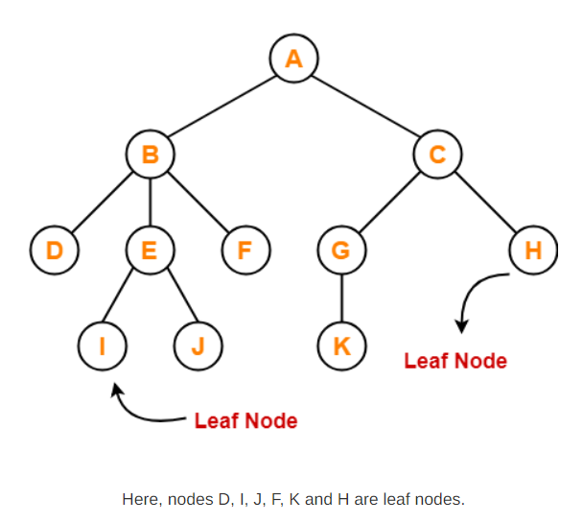
Leaf Node
The node which does not have any child is called as a leaf node.
Leaf nodes are also called as external nodes or terminal nodes.

Slide 18
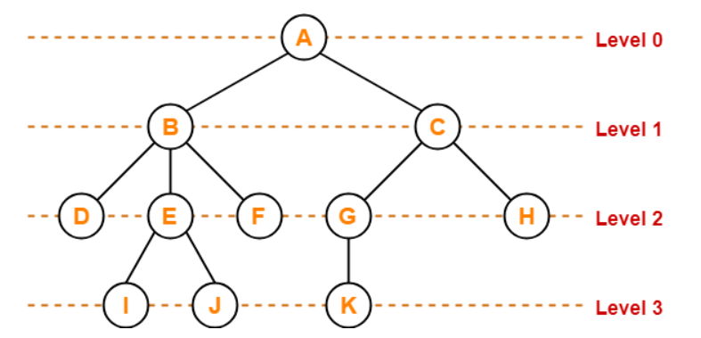
Level
In a tree, each step from top to bottom is called as level of a tree.
The level count starts with 0 and increments by 1 at each level or step.

Slide 19
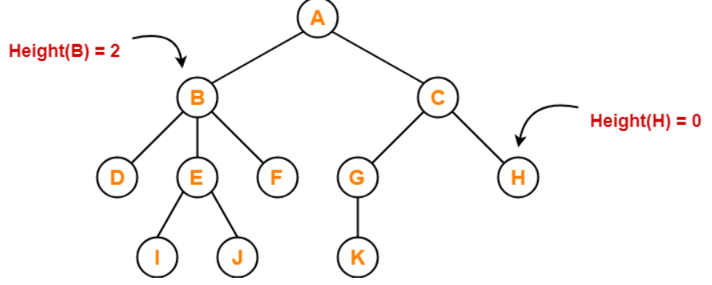
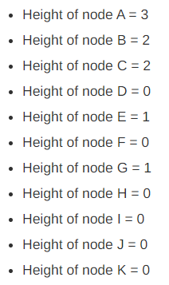
Height
Total number of edges that lies on the longest path from any leaf node to a particular node is called as height of that node.
Height of a tree is the height of root node.
Height of all leaf nodes = 0

Slide 20
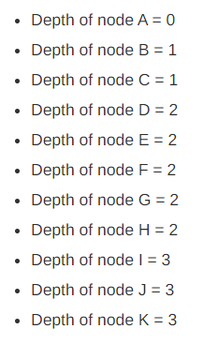
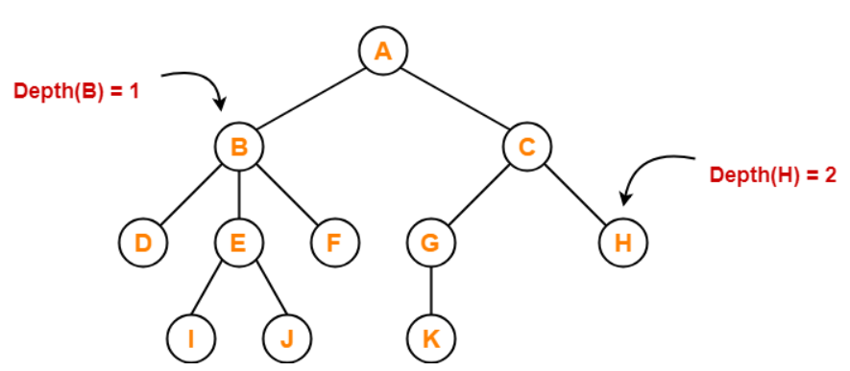
Depth
Total number of edges from root node to a particular node is called as depth of that node.
Depth of a tree is the total number of edges from root node to a leaf node in the longest path.
Depth of the root node = 0
The terms “level” and “depth” are used interchangeably.

Slide 21
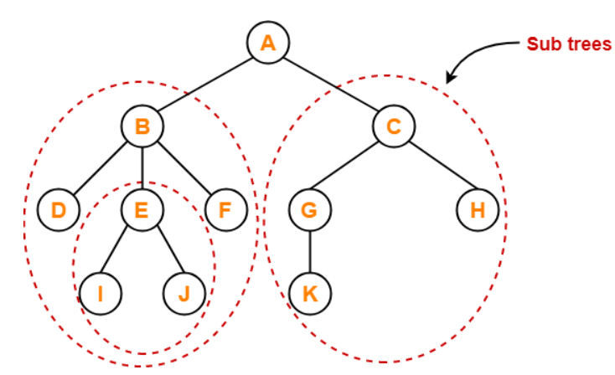
Subtree
In a tree, each child from a node forms a subtree recursively.
Every child node forms a subtree on its parent node.

Slide 22
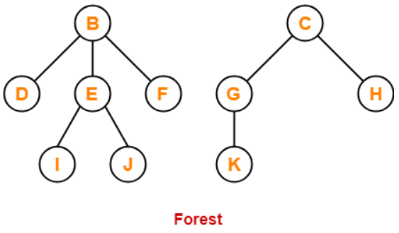
Forest
A forest is a set of disjoint trees.

Slide 23
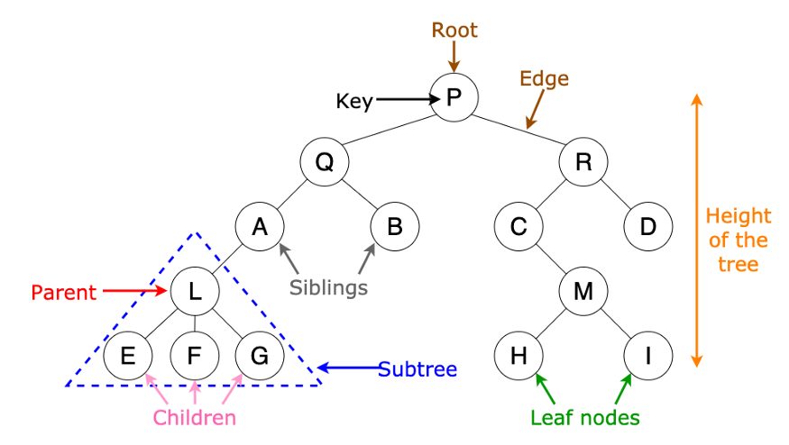
Terminologies

Slide 24
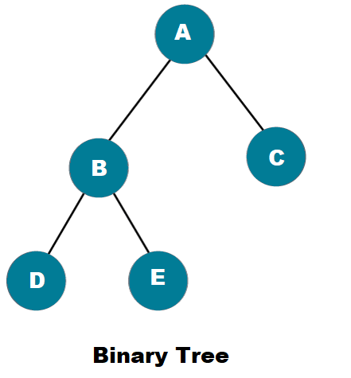
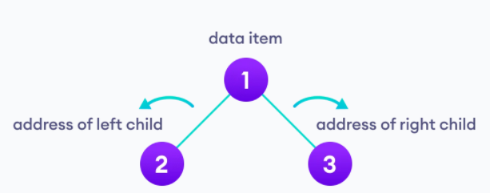
Binary Tree
A binary tree is a tree data structure in which each parent node can have at most two children.
Each node of a binary tree consists of three items:
data item
address of left child
address of right child

Slide 25
Properties of a Binary tree
A binary tree is either an empty tree or consists of a node called the root node, a left subtree, and a right subtree. The subtrees will also act as a binary tree once.
The top-most node is called the root.
A node without children is called a leaf node or terminal node.
The maximum number of nodes at each level of i is 2i.
Height of the tree = the longest path from the leaf node to the root node.
Depth of a node = the length of the path to its root.

Slide 26
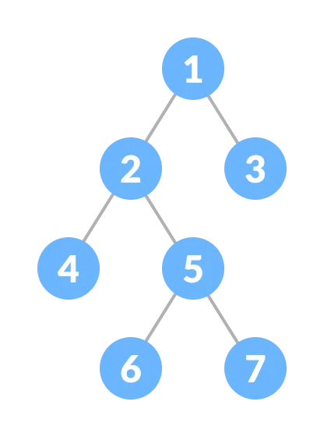
1. Full/proper Binary Tree
A full Binary tree is a special type of binary tree in which every parent node/internal node has either two or no children.
It is also known as a proper binary tree.

Slide 27
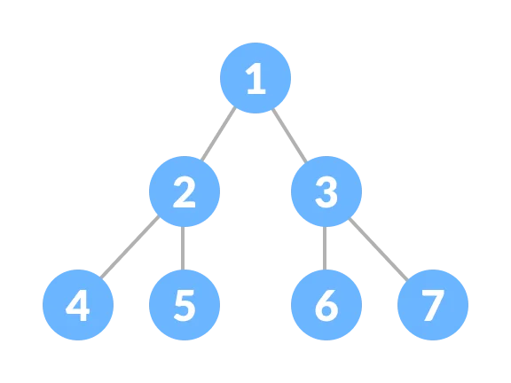
2. perfect binary tree
A perfect binary tree is a type of binary tree in which every internal node has exactly two child nodes and all the leaf nodes are at the same level.

Slide 28
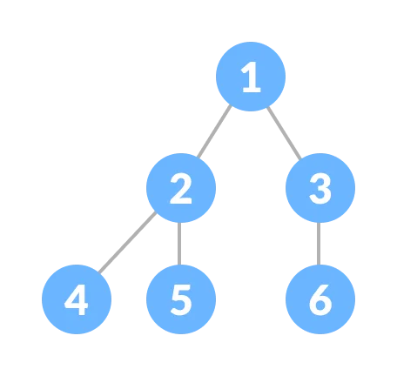
3. Almost Complete Binary Tree
A complete binary tree is just like a full binary tree, but with two major differences:
Every level must be completely filled
All the leaf elements must lean towards the left.
The last leaf element might not have a right sibling i.e. a complete binary tree doesn't have to be a full binary tree.

